Slide 1
DIVERSITY,
EQUITY & INCLUSION
CELL (DEI)
Our Bouquet of activities
Your Opportunities
Linking to courses

Slide 2
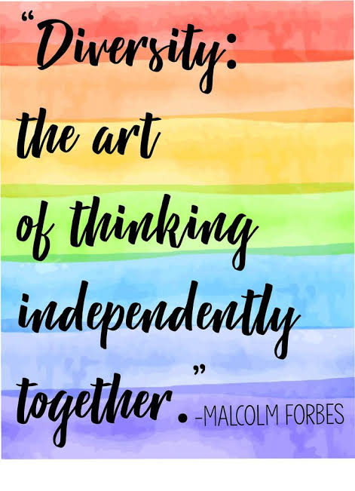

Slide 3
Diversity, is not only a choice.
It’s a Business Mandate

Slide 4
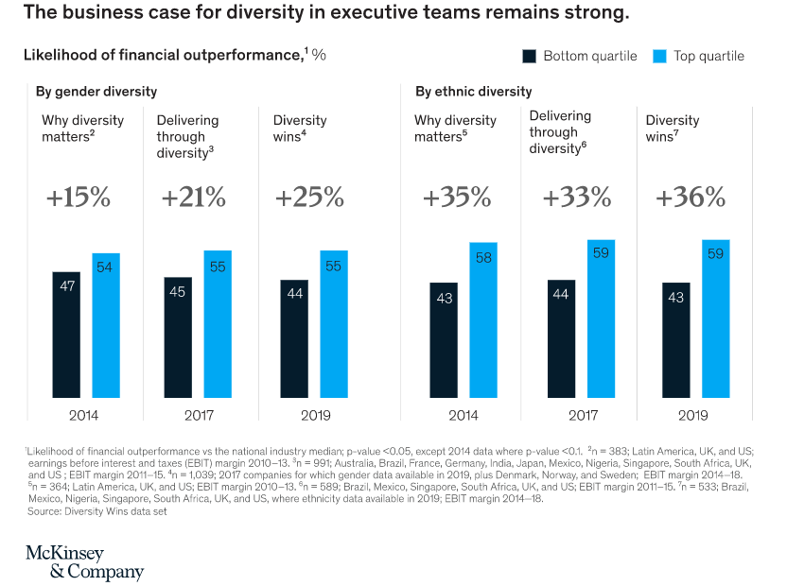

Slide 5
OBJECTIVES
Build a diverse, equitable, and inclusive ecosystem
Nurturing sense of belongingness
Promoting the voice of the underrepresented
Foster dignity and respect in the workplace

Slide 6
Our Activities

Slide 7
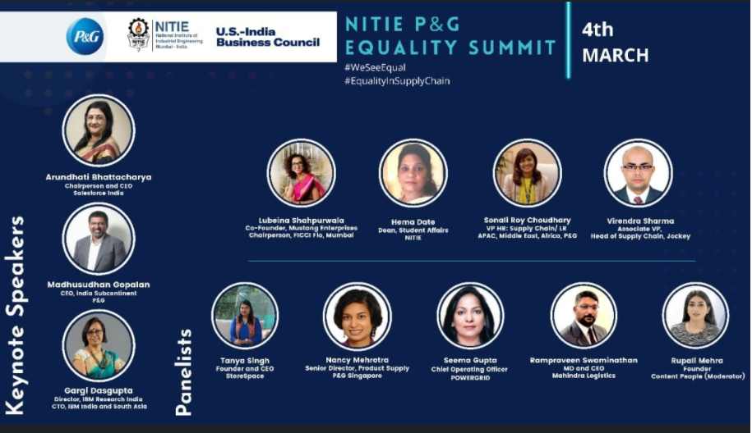
MoU with P&G

Slide 8
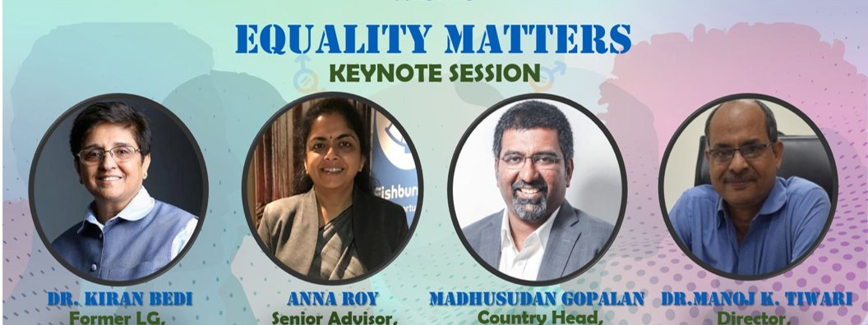
P&g nitie equality summit 2021

Slide 9

NITIE-P&G Equality Summit 2022

Slide 10
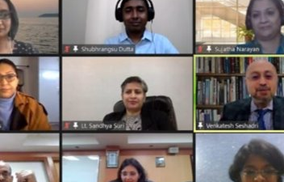
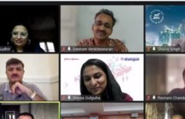
PANEL DISCUSSION WITH INDUSTRY EXPERTS
Leaders of Change: Women in Supply Chain Rainbow Strategy: Synergizing Diversity Spectrum

Slide 11
Enhancing women representation on shopfloor

Slide 12

NITIE has academic co-partnership with SheMaker Summit 2022 to support vision to build a future of manufacturing where woman have equal power & voice as makers and leaders.

Slide 13
Building Diverse Ecosystem

Slide 14
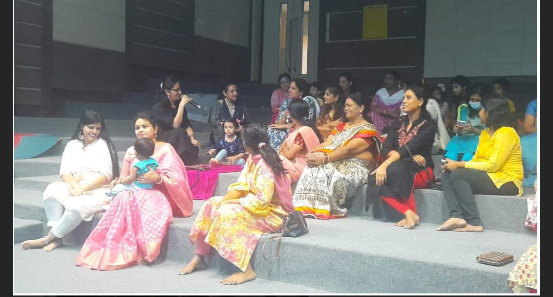
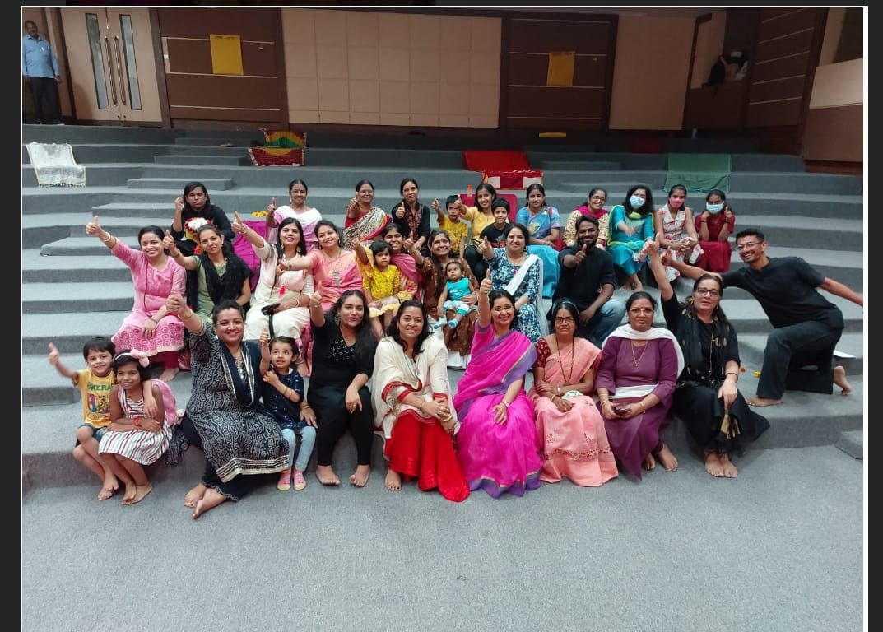
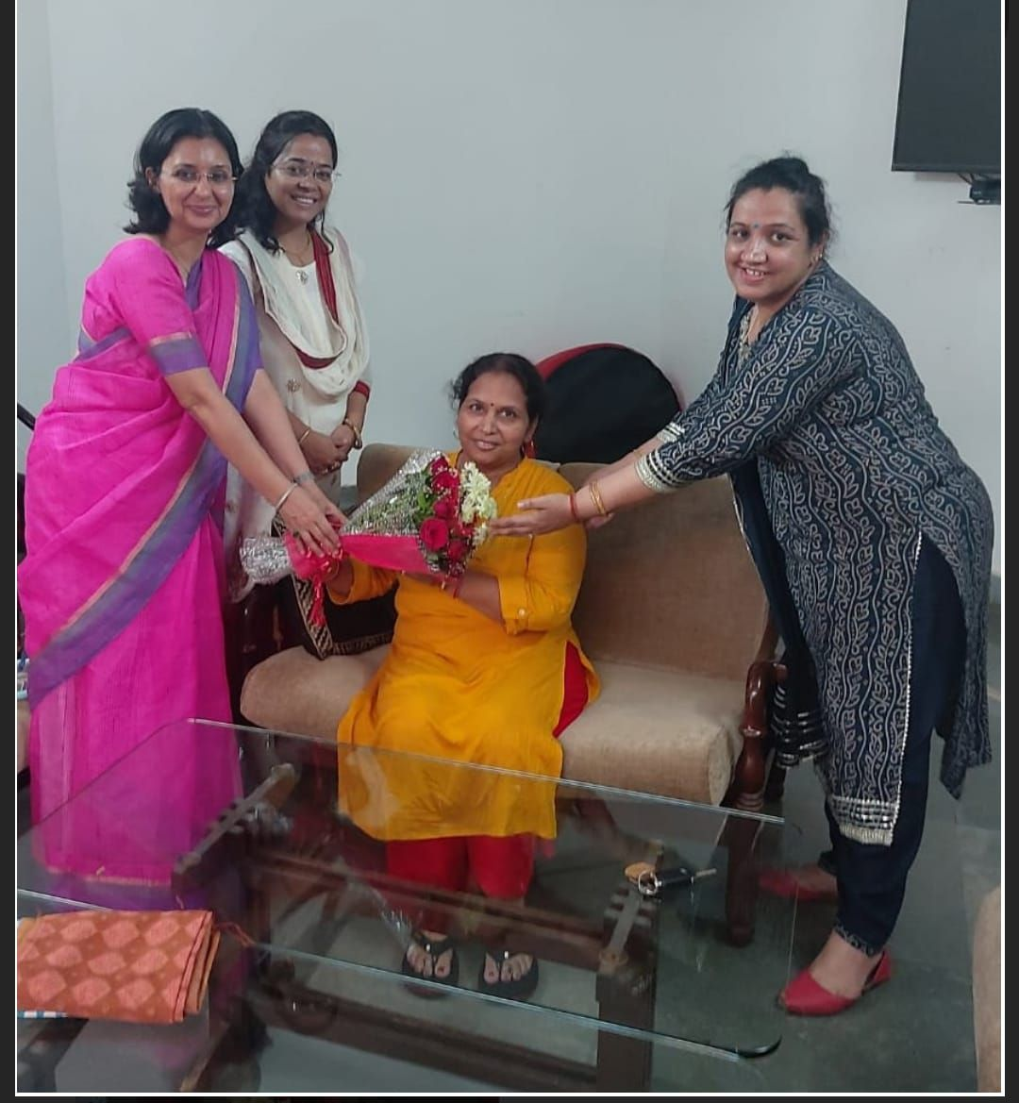
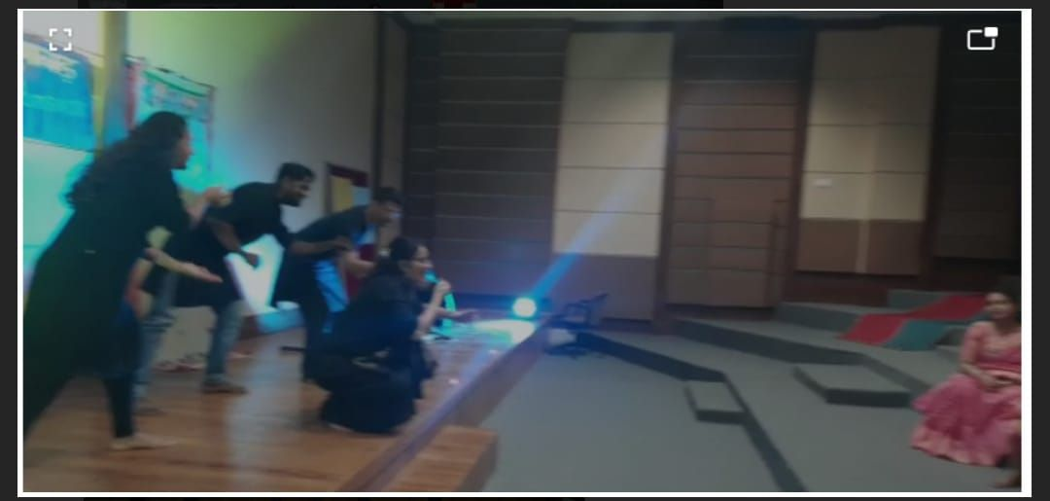
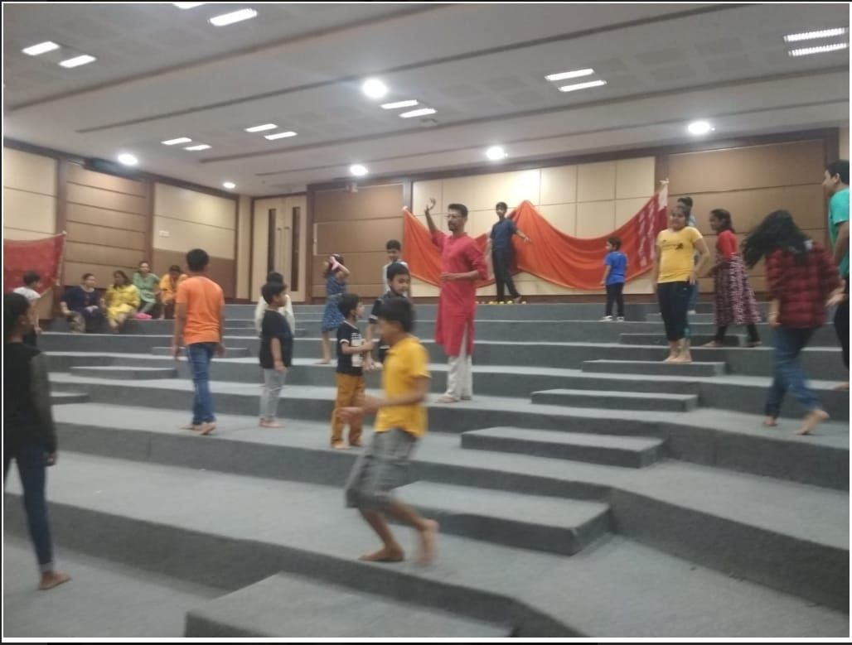
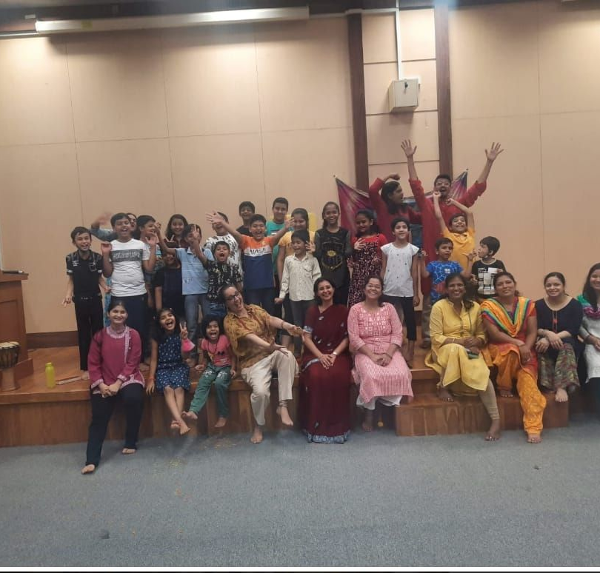
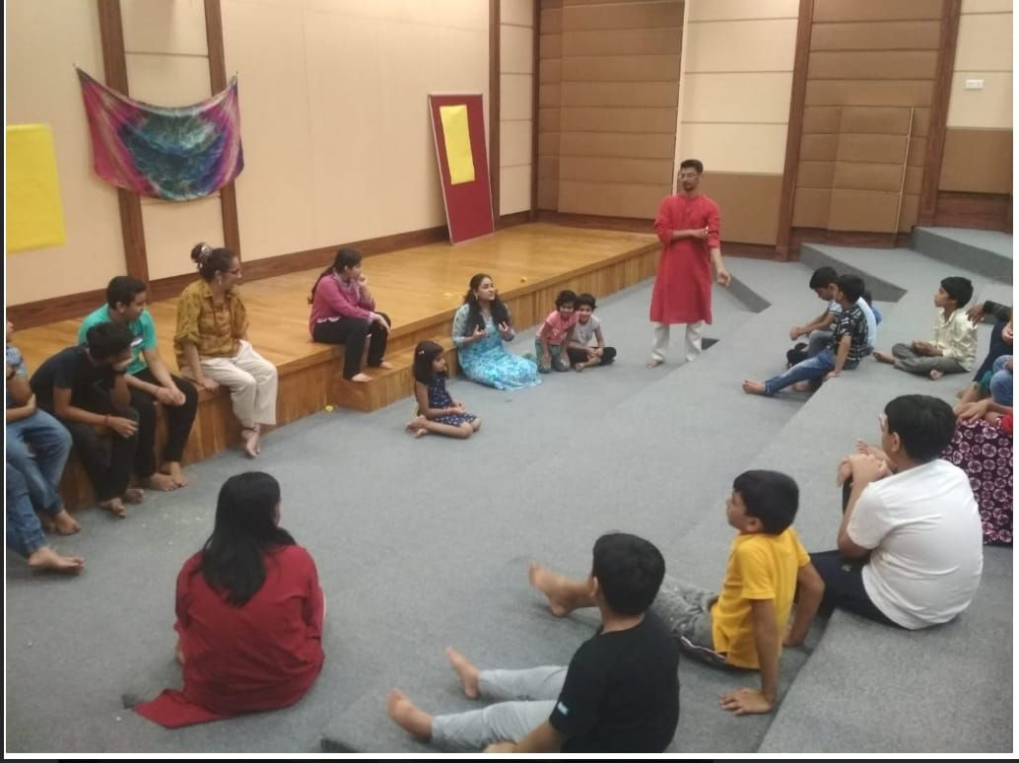
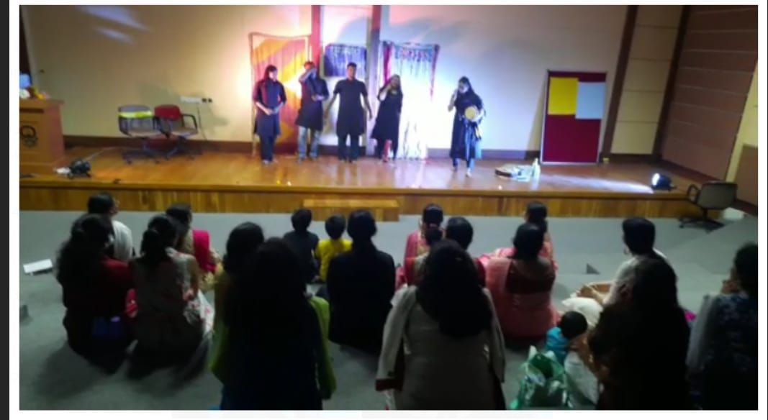

Slide 15
Creating Social Impact through Mentoring

Slide 16
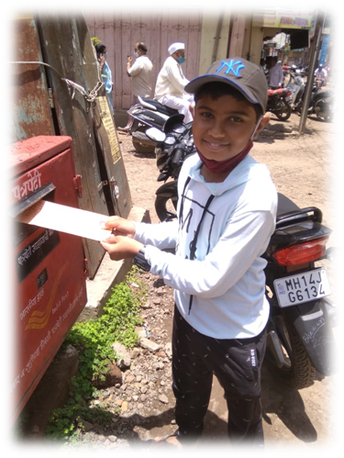
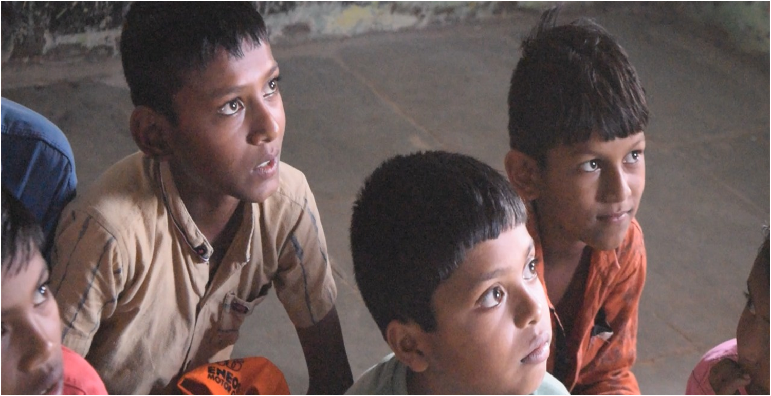
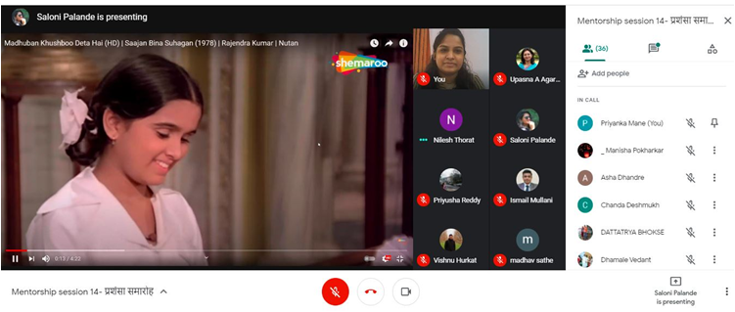
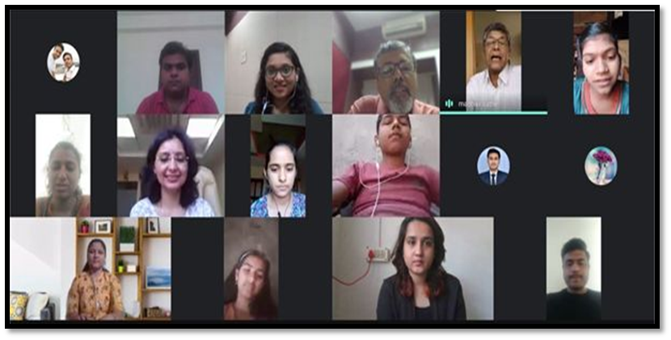
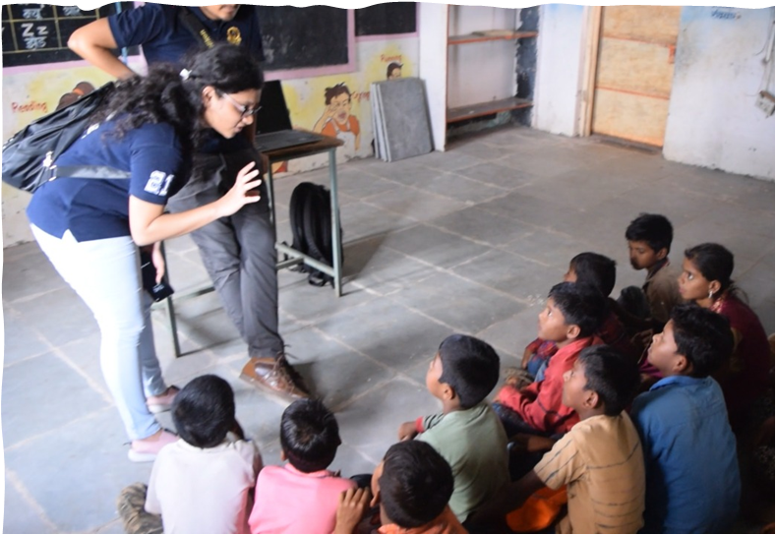
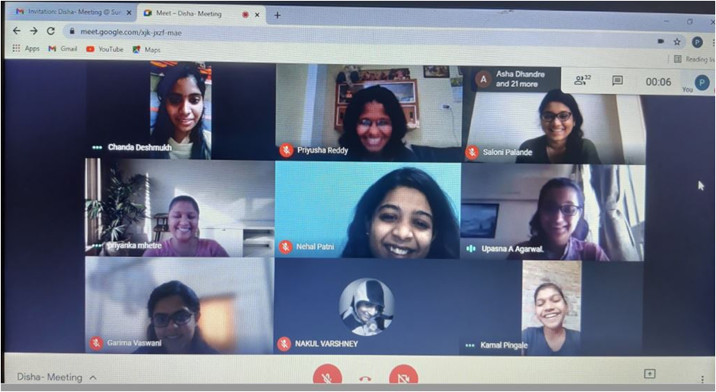
parivartan
Notes:
A nation’s growth requires the productive contribution of all segments of society, particularly the children and the youth, who need to be provided opportunities for self-expression. Household and national investments in children and youth yield long-term returns in terms of high productivity of the economically active population till they enter the elderly cohort.
https://india.unfpa.org/en/news/reaping-indias-demographic-dividend
The SRS report, an annual publication from the office of the census commissioner and registrar general, estimates that in 2018, nearly two-thirds of the population, or 66%, was between 15 and 59

Slide 17

Project Parivartan: Social Initiatives
‘Enhancing Technology Enabled Holistic Learning in Rural School’ (NEP 2020)
SDGs 5 and 10 (gender equity and reducing inequalities)
33 PGP Students as Mentors: Rural Kids mentee dyads
Weekly online Mentoring
Over 65 weeks of engagement on various themes
16 Videos also created on science and life skills
Commended by Hon. Union Minister for Education
Positive feedback from all stakeholders: mentees, mentors, parents, teachers
Notes:
A nation’s growth requires the productive contribution of all segments of society, particularly the children and the youth, who need to be provided opportunities for self-expression. Household and national investments in children and youth yield long-term returns in terms of high productivity of the economically active population till they enter the elderly cohort.
https://india.unfpa.org/en/news/reaping-indias-demographic-dividend
The SRS report, an annual publication from the office of the census commissioner and registrar general, estimates that in 2018, nearly two-thirds of the population, or 66%, was between 15 and 59

Slide 18
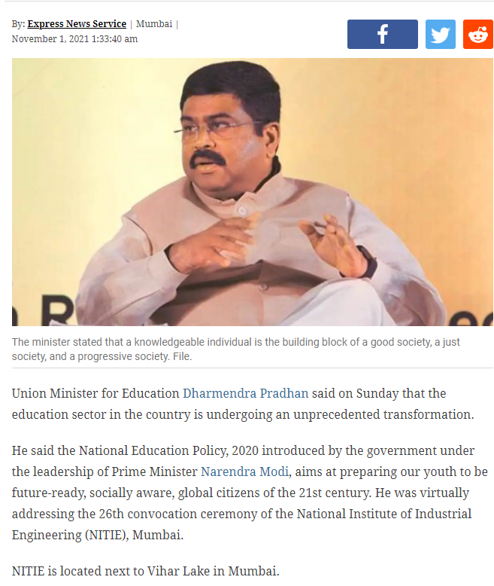
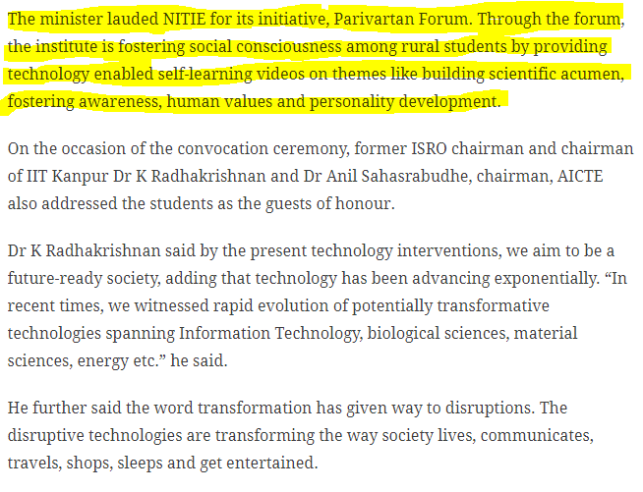
Parivartan’s Accomplishments
Notes:
A nation’s growth requires the productive contribution of all segments of society, particularly the children and the youth, who need to be provided opportunities for self-expression. Household and national investments in children and youth yield long-term returns in terms of high productivity of the economically active population till they enter the elderly cohort.
https://india.unfpa.org/en/news/reaping-indias-demographic-dividend
The SRS report, an annual publication from the office of the census commissioner and registrar general, estimates that in 2018, nearly two-thirds of the population, or 66%, was between 15 and 59

Slide 19

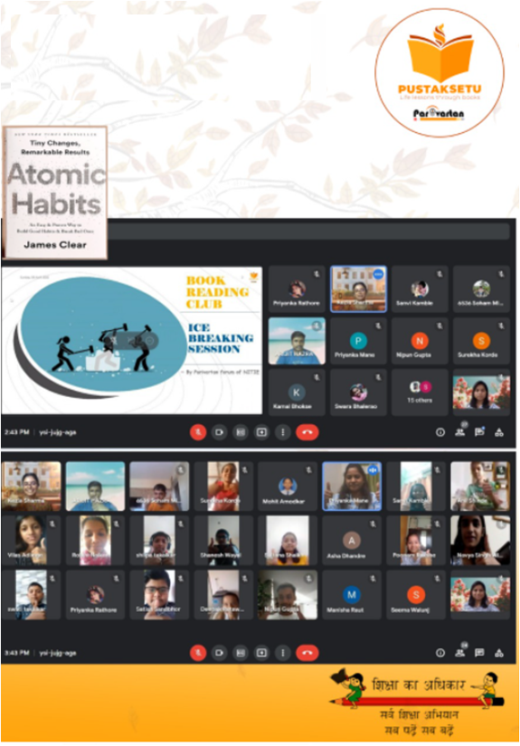
Book Reading Club
Notes:
A nation’s growth requires the productive contribution of all segments of society, particularly the children and the youth, who need to be provided opportunities for self-expression. Household and national investments in children and youth yield long-term returns in terms of high productivity of the economically active population till they enter the elderly cohort.
https://india.unfpa.org/en/news/reaping-indias-demographic-dividend
The SRS report, an annual publication from the office of the census commissioner and registrar general, estimates that in 2018, nearly two-thirds of the population, or 66%, was between 15 and 59

Slide 20
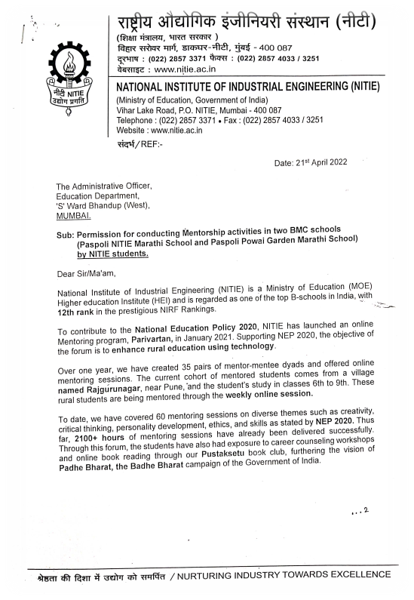
capstone module social impact
Notes:
A nation’s growth requires the productive contribution of all segments of society, particularly the children and the youth, who need to be provided opportunities for self-expression. Household and national investments in children and youth yield long-term returns in terms of high productivity of the economically active population till they enter the elderly cohort.
https://india.unfpa.org/en/news/reaping-indias-demographic-dividend
The SRS report, an annual publication from the office of the census commissioner and registrar general, estimates that in 2018, nearly two-thirds of the population, or 66%, was between 15 and 59

Slide 21
Opportunities for you
To be a part of the DEI cell
Enhance awareness
Creating conversations through panel discussions with industry experts
Screening movies on DEI followed by discussions
Inviting celebrities to share their perspectives on different aspects of DEI
Culminating the learnings of DEI course into capstone project in module 6

Slide 22
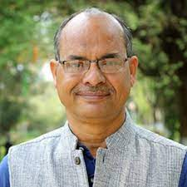
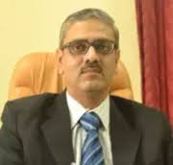
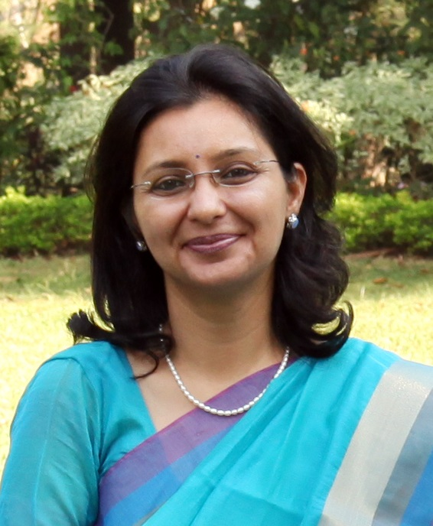
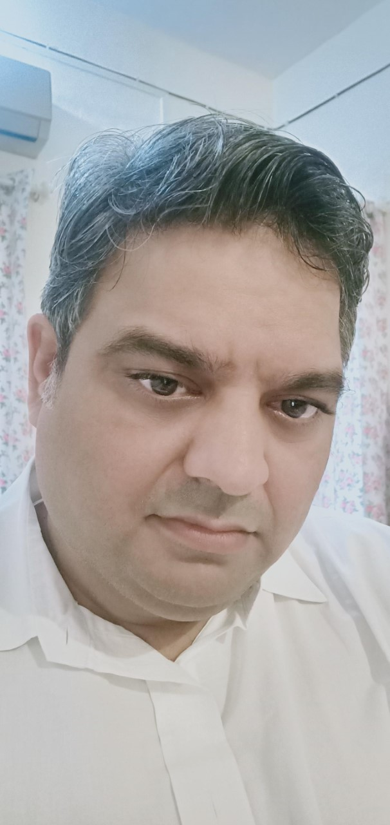
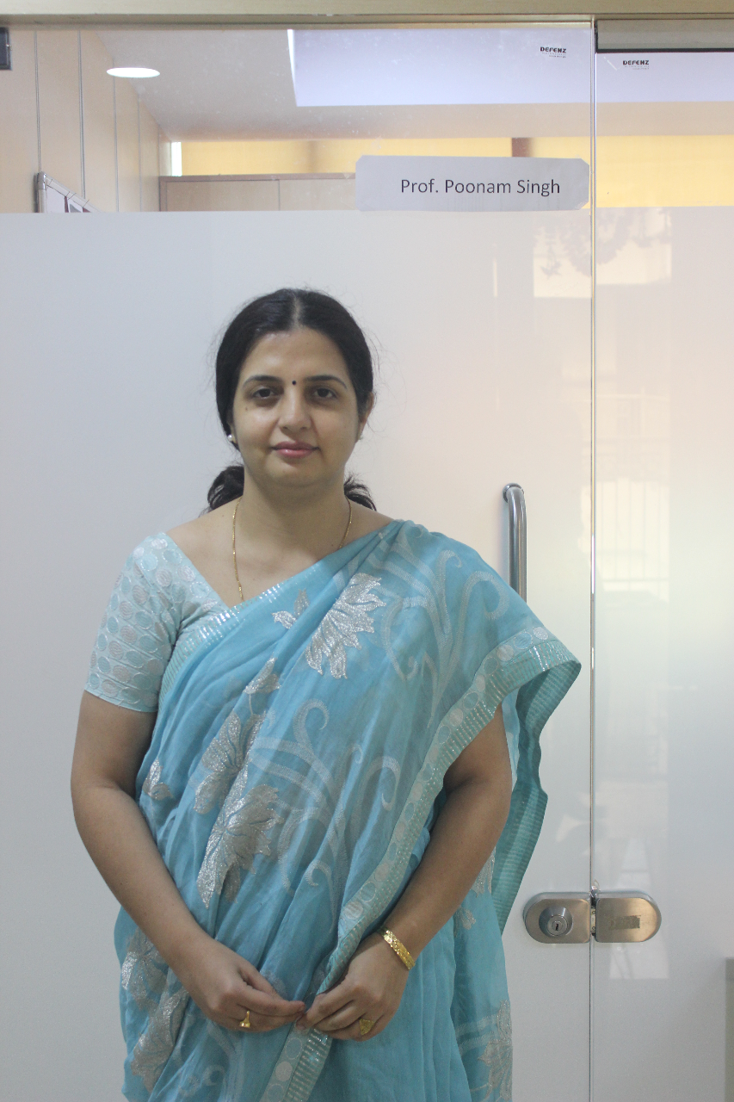
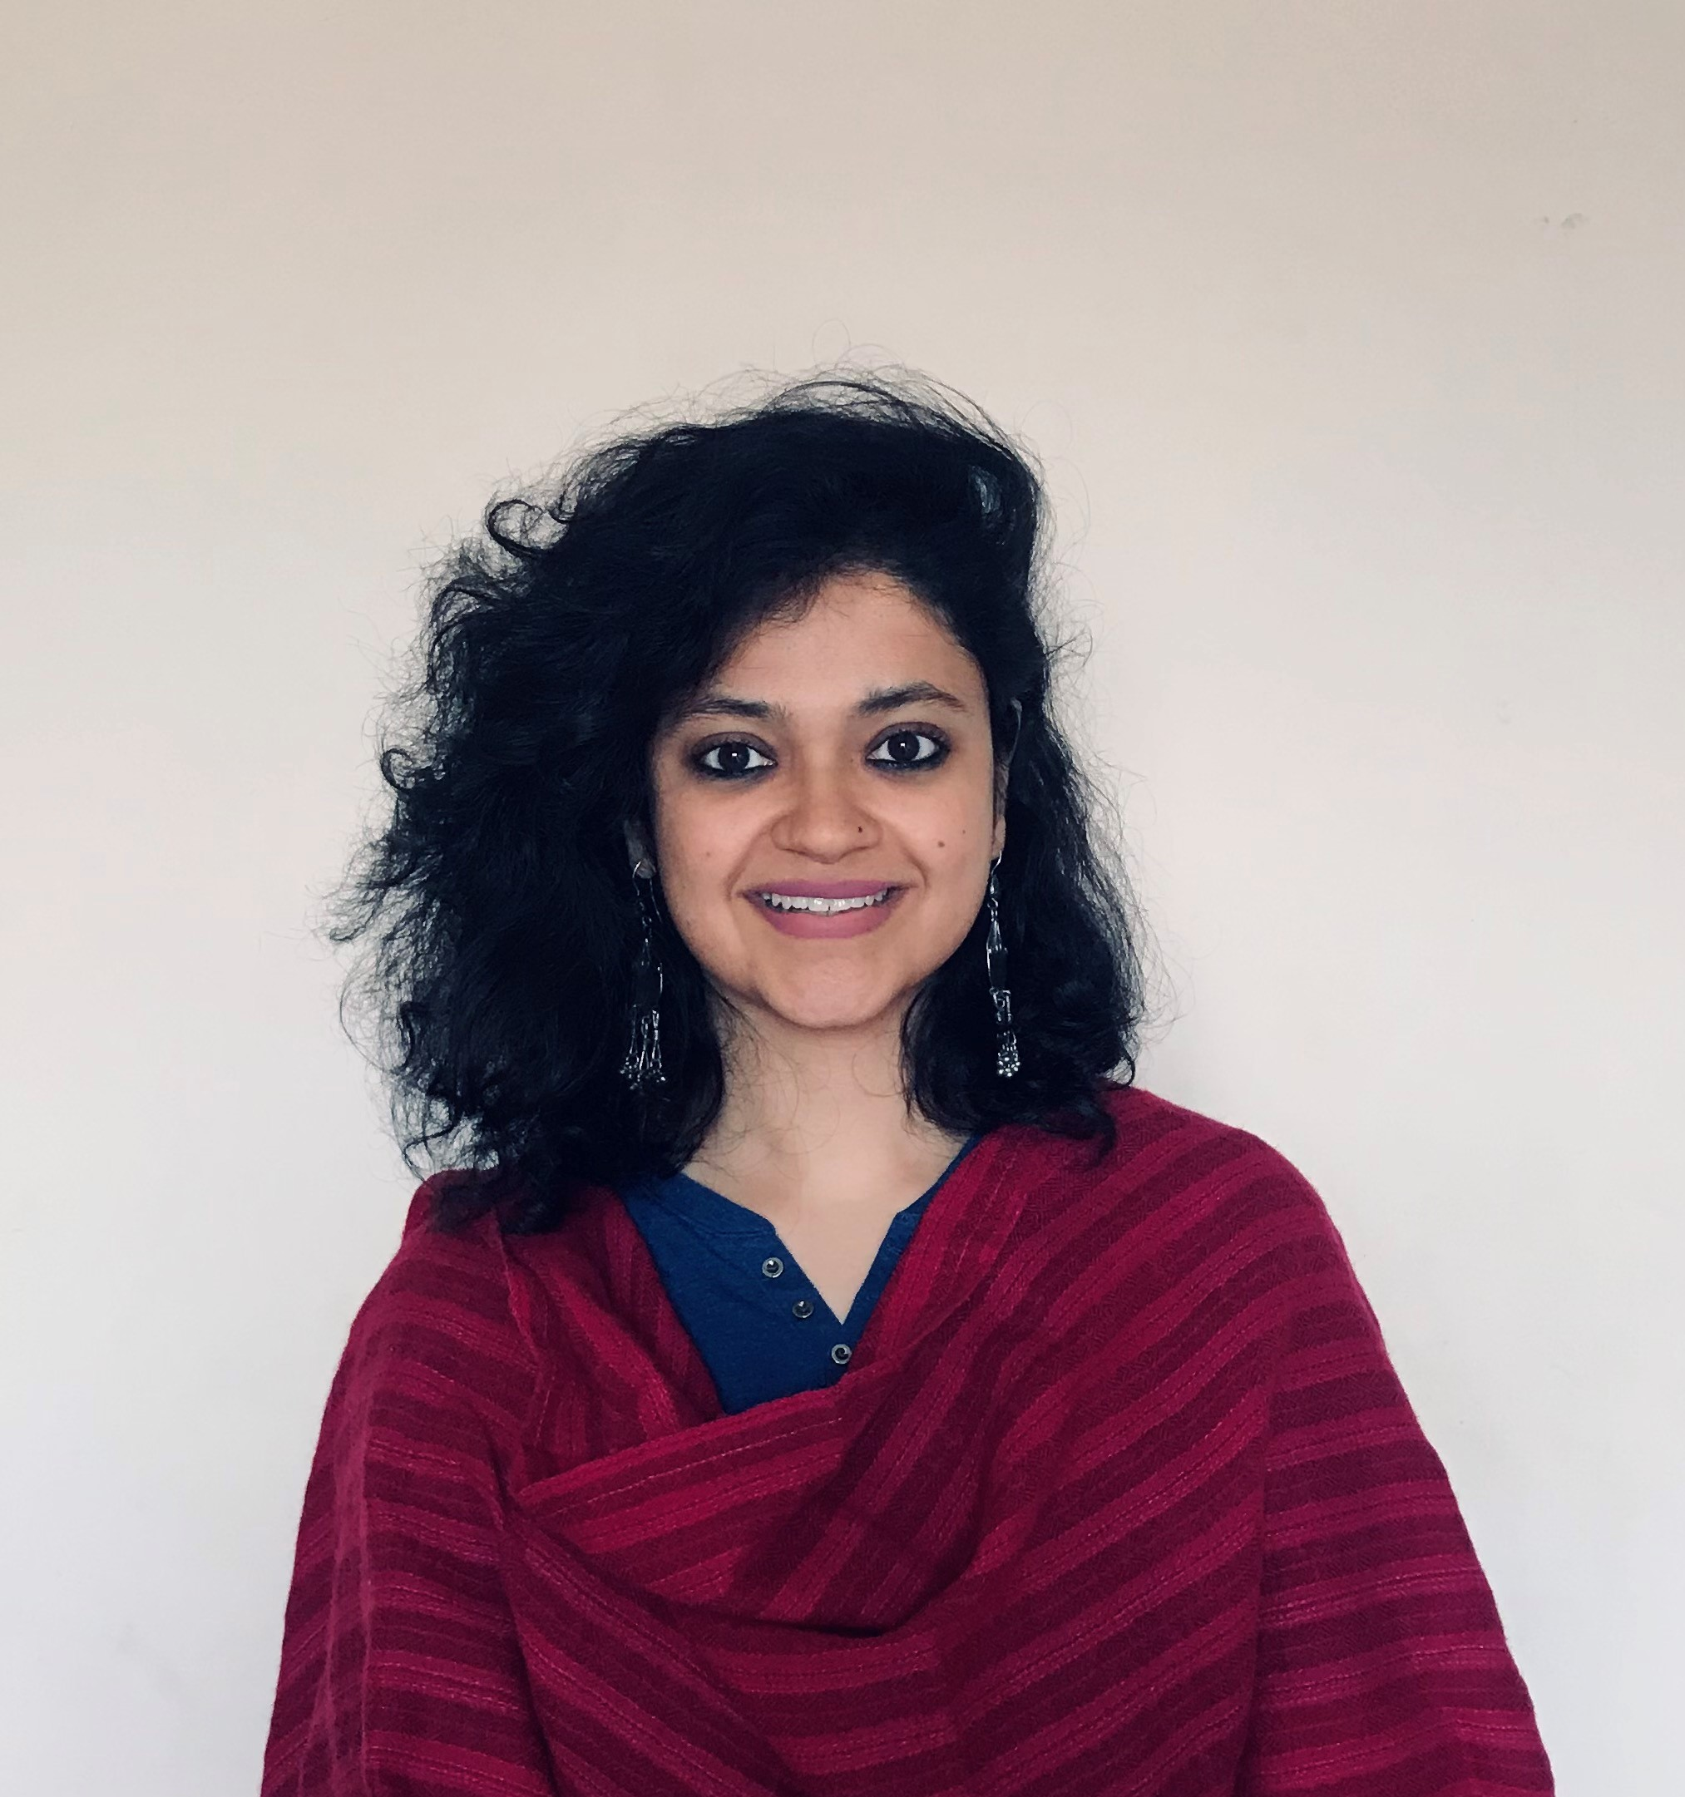
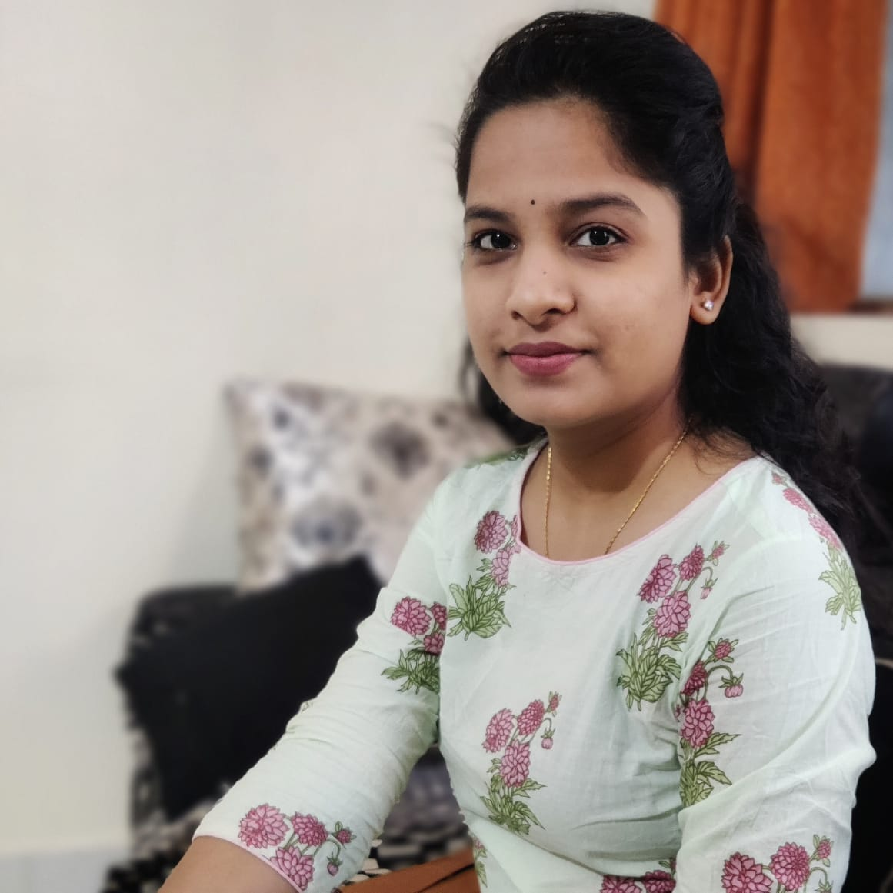
DEI TEAM
Prof. Manoj Kumar Tiwari
Prof. Vivek Khanzode
Prof. Upasna A Agarwal
Prof. Nikhil K Mehta
Prof. Poonam Singh
Prof. Megha Gupta
Ms R.A. Priyanka Mane

Slide 23
THANKYOU

